Slide 1
Developer view of DESIGN
MV’s

Slide 2
A&A
Analysis or Analytics

Slide 3

WHO AM I a WEBER

Slide 4





The Communication
z

Slide 5
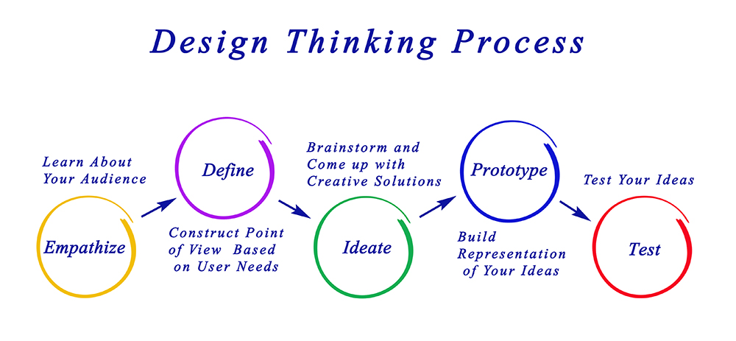
Design Thinking Process

Slide 6
The best 3
Be Natural while develop
Think like Business Owner and Developer but 1st as a customer
Ask yourself – will I visit this website

